Slide 1
Data Mind – {Logo+Punchline TM}

Slide 2
Class 5: Table of Contents
Validation
What is model validation?
Why is it necessary?
How do we do it?

Slide 3
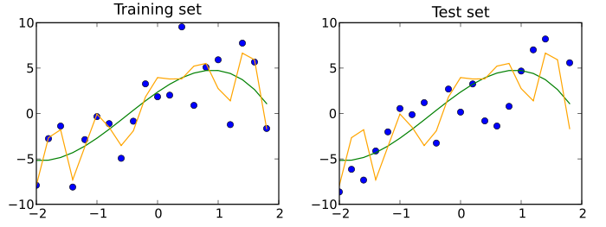
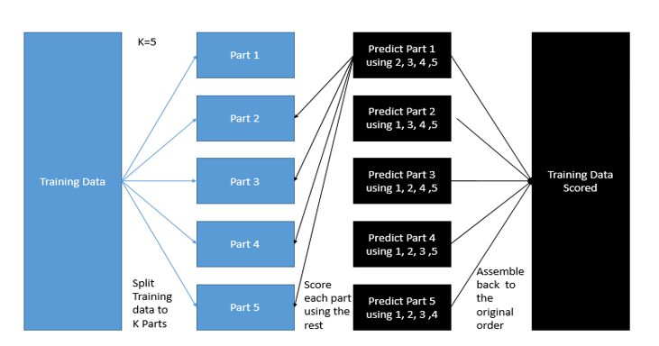
Class 5: Model validation is a key step to evaluating any Machine Learning model. It tells us how our model is doing on ‘unseen’ data; which is what we want to evaluate models on in the real-world application sense
Recall from the previous class, we had validation strategy as key step to data science modelling. We basically, divide the dataset into training data and validation data with the purpose of model building on training data and evaluation on validation data.
Complete Dataset
Training Dataset
(80%)
Validation/Test Dataset
(20%)
Build Model
Evaluate Model Performance
More than 1 ways to do validation:
80%-20% / 75%-25% - split of train and validation set
k-fold cross validation –
Divide dataset into k equal parts
For each k-1 parts build model
Evaluate on k^{th} part
Repeat and avg errors
Report avg as most likely estimate of metric in consideration
Most common; k is usually 5 or 10.
k fold stratified cross validation
Similar to k fold cv
test, train indexes as stratified across specified variable
Leave p out CV –
LeavePOut is very similar to LeaveOneOut as it creates all the possible training/test sets by removing p samples from the complete set
Least common

